Slide 1

Financial Headlines Sentiment Analysis
A Transfer Learning Approach

Slide 2
The Problem
What?
Predict the sentiment (positive or negative) of financial news headlines
How?
NLP (Python, Spacy)
LSTM Neural Network (Pytorch/FastAI) + Transfer Learning
With?
Dataset: 1,945 financial news headlines labelled as positive or negative

Slide 3
From text to numbers
The expansion aims to attract new customers both in Finland and .
NLP
Expansion / Attract / New Customers
3 positive words → Positive sentiment

Slide 4
From text to numbers
By cutting the number of plants , the group will trim fixed costs
NLP
Cut / Plants / Trim / Cost
3 Negative Words → But the sentiment is positive

Slide 5
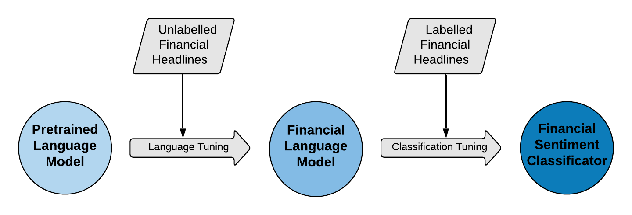
The Power of Transfer Learning
90% Accuracy
Trained only with 1,945 headlines
Easy to adapt to other context

Slide 6
Next Steps 🚀
Include Neutral Sentiment as a classification class
Deploy the application in a business environment
Study the impact on the model accuracy of adding more labelled data to the training set

